Slide 1
EMBEDDED
An embedded system is a microprocessor- or microcontroller-based system of hardware and software designed to perform dedicated functions within a larger mechanical or electrical system.
Embedded systems are commonly found in consumer, cooking, industrial, automotive, and medical applications. Some examples of embedded systems are MP3 players, mobile phones, video game consoles, digital cameras, DVD players, and GPS.

Slide 2
C and EMBEDDED C
C:
C used for desktop based applications
C code generate the compatible .exe files
It has limitless resources like memory
C language uses the desktop os memory
NO need of hardware knowledge
Embedded C:
It is used for micro controller based applications
Embedded programs generate the .hex files
It has limited resources like memory(RAM,ROM)
Embedded programming uses the micro controller inbuilt memory
need of hardware knowledge

Slide 3
UCONTROLLER VS UPROCESSOR
Microprocessor | Microcontroller
Microprocessor is the heart of Computer system. | Micro Controller is the heart of an embedded system.
It is only a processor, so memory and I/O components need to be connected externally | Micro Controller has a processor along with internal memory and I/O components.
Memory and I/O has to be connected externally, so the circuit becomes large. | Memory and I/O are already present, and the internal circuit is small.
You can't use it in compact systems | You can use it in compact systems.
Cost of the entire system is high | Cost of the entire system is low

Slide 4
PIC
PIC microcontrollers are manufactured by Microchip. They are available in 8-bit, 16-bit, and 32-bit.
The PIC microcontroller is based on RISC architecture.
Its memory architecture follows the Harvard pattern of separate memories for program and data, with separate buses.

Slide 5
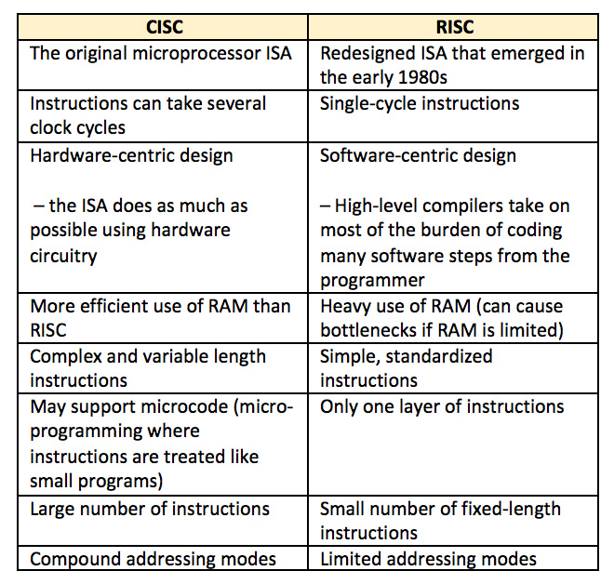
RISC and CISC

Slide 6
VON NEUMANN VS HARVARD ARC
VON NEUMANN ARCHITECTURE | HARVARD ARCHITECTURE
Same physical memory address is used for instructions and data. | Separate physical memory address is used for instructions and data.
There is common bus for data and instruction transfer. | Separate buses are used for transferring data and instruction.
Two clock cycles are required to execute single instruction. | An instruction is executed in a single cycle.
It is cheaper in cost. | It is costly than van neumann architecture.

Slide 7
PIC16F887
PIC-Pheriferal interface controller
16-series
F-flashable
8-bit controller
87-Product Number

Slide 8
FEATURES
Software selectable frequency range of 8 MHz to 31 kHz & by Hardware 20MHZ
Software tunable
5 RESET tech
100,000 write Flash endurance
1,000,000 write EEPROM endurance
Power-Saving Sleep mode
Wide Operating Voltage Range (2.0V-5.5V)

Slide 9
PHERIPHERALS
A/D Converter:
10-bit resolution and 14 channels
Timer0: 8-bit Timer/Counter with 8-bit
Programmable Prescaler
Timer1:16-bit timer/counter with prescaler
Timer2: 8-bit Timer/Counter with 8-bit Period
Register, Prescaler and Postscaler,Enhanced Capture, Compare, PWM+.

Slide 10
REGISTER
GENERAL PURPOSE REGISTER
SPECIAL FUNCTION REGISTER
GENERAL PURPOSE:
EX; PORT_,TRIS_,ANSEL,ANSELH
SPECIAL FUNCTION:
EX;TIMER AN D ADC ENABLE REGISTER

Slide 11
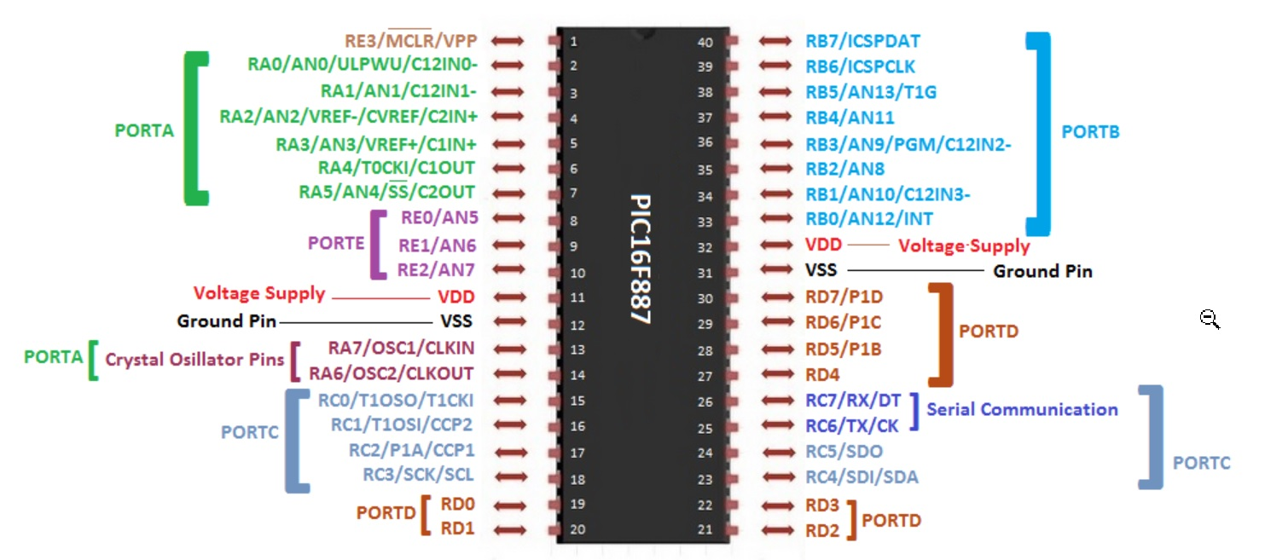
PIN DIAGRAM

Slide 12
PORTS
5 PORTS
PORTA=8PINS
POTRB=8PINS
PORTC=8PINS
PORTD=8PINS
PORTE=3PINS
2-VDD
2-VSS
1-RESET PIN
In this 35 i/o pin which includes 2 external oscillator connection pins.

Slide 13
Example Program
#include<pic.h>
void main()
{
PORTA=0x00;
TRISA=0x00;
ANSEL=0X00;
ANSELH=0X00;
while(1)
{
PORTA=0X04;
}
}

